Slide 1
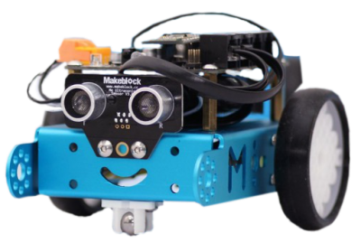
setup

Slide 2
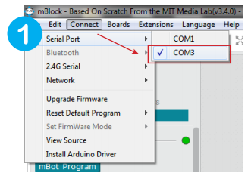
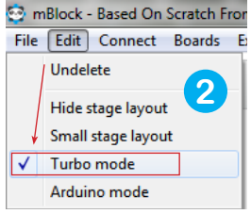
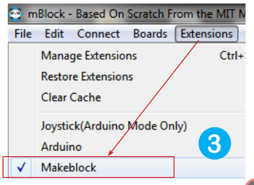
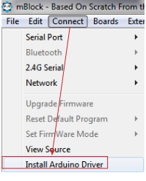
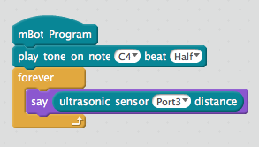
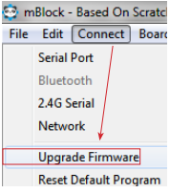
Plug in the mBot cable to the computer and turn the mBot on
Can’t see the serial port?
TEST Connection:

Slide 3
http://www.smartschoolsystems.com/downloads/Getting_Started_with_mBot___iPad.pdf
http://download.makeblock.com/mblock/docs/getting-started-with-mblock.pdf

